Slide 1

CBCI Office for Education and Culture Releases Four Landmark Volumes on Catholic Education

Slide 2
In a landmark contribution to the field of faith-based education, the CBCI Office for Education and Culture has released four new books that together chart a comprehensive vision for Catholic education in India and beyond. These volumes—Catholic Educators: Heralds of Transforming Education, The Teachings of the Catholic Church on Education, Saint Educators: The Story of Holiness and Education in the Church, and Education 5.0: Nurturing Gen Next for Excellence and Service—reflect the Office’s ongoing mission to form leaders, inspire renewal, and strengthen the Catholic educational apostolate across the nation.

Slide 3
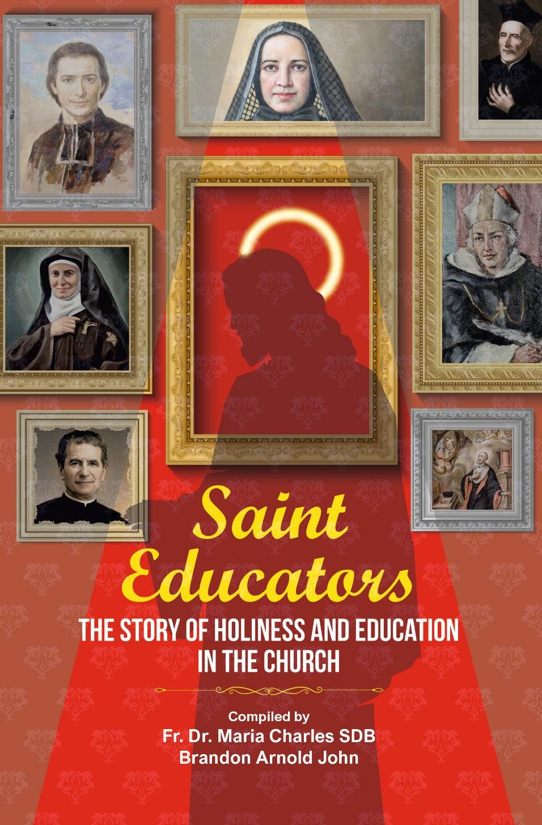
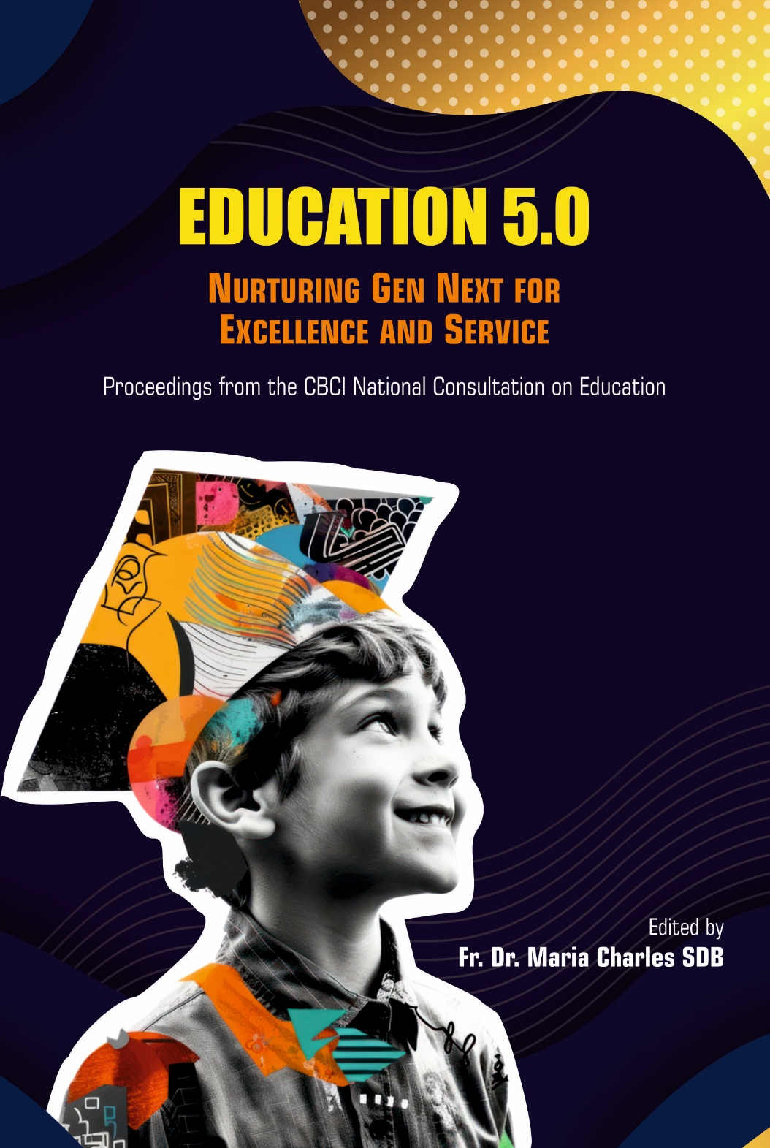
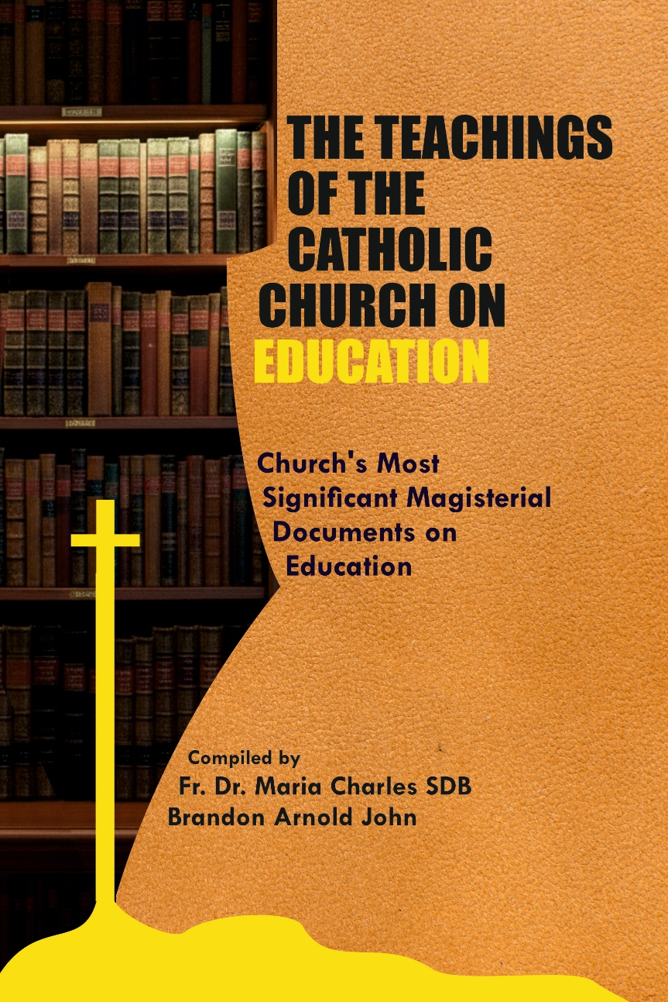
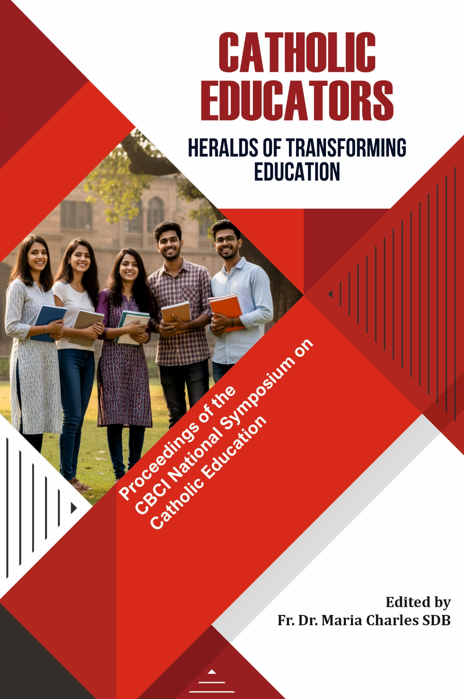
NEW BOOKS BY
CBCI OFFICE FOR EDUCATION AND CULTURE
THE TEACHINGS OF THE CATHOLIC CHURCH ON EDUCATION
Church’s Most Significant Magisterial Documents on Education
EDUCATION 5.0
Nurturing Gen Next for Excellence and Service
SAINT EDUCATORS
The Story of Holiness and Education in the Church
THE TEACHINGS OF THE CATHOLIC CHURCH ON EDUCATION
Church’s Most Significant Magisterial Documents on Education
CATHOLIC EDUCATORS
Heralds of Transforming Education
CATHOLIC EDUCATORS
Heralds of Transforming Education
EDUCATION 5.0
Nurturing Gen Next for Excellence and Service
SAINT EDUCATORS
The Story of Holiness and Education in the Church

Slide 4
Education 5.0: Nurturing Gen Next for Excellence and Service
Addressing the challenges and opportunities of the digital age, this forward-looking volume explores how Catholic education can respond to emerging technologies, innovation, and socio-cultural shifts while remaining grounded in Gospel values. It proposes a model of “Education 5.0” that combines excellence with service—forming young people who are intellectually competent, ethically grounded, and socially engaged. With insights on AI, digital literacy, ecological education, and inclusive pedagogy, it calls Catholic institutions to lead with creativity and conscience.

Slide 5
The Teachings of the Catholic Church on Education
Drawing from the rich magisterial tradition of the Church—from Gravissimum Educationis to Veritatis Gaudium—this scholarly volume presents the foundational principles of Catholic education. It serves as a vital reference for educators, administrators, and researchers who seek to understand education as a ministry of integral human formation. The book traces how the Church views education as a partnership between faith and reason, nurturing wisdom, conscience, and the pursuit of truth.

Slide 6
Saint Educators: The Story of Holiness and Education in the Church
This inspiring collection brings to life the stories of great saint-educators—from St. John Bosco and St. Elizabeth Ann Seton to St. Albertus Magnus and St. Claudine Thévenet—whose lives embody the union of holiness and pedagogy. Each chapter illustrates how education becomes a path to sanctity, and how holiness itself becomes the most compelling form of teaching. The book invites today’s educators to rediscover the spiritual roots of their vocation in the witness of these luminous figures.

Slide 7
Catholic Educators: Heralds of Transforming Education
This volume celebrates the vocation of Catholic educators as agents of transformation in today’s complex world. Through reflective essays and case studies, it highlights the sacred calling of teachers who not only impart knowledge but awaken faith, compassion, and moral vision in their students. Rooted in Pope Francis’ Global Compact on Education, the book reminds educators that true education transforms both the learner and the teacher through a dialogue of life, values, and hope.

Slide 8
Thank you

